Slide 1
CRMNXT
Samraat Gupta,Jason Li, Prachi Miyan, Amith Kini Mattar and Yen Hua Lin

Slide 2
Introduction
CRMNXT is a user management and analysis tracking for the group of applications managed by FashionNXT.
The app is built using Ruby on Rails and equipped with JavaScript, HTML and CSS.

Slide 3
Features
Events 360 Homepage
Unified User Dashboard
Forgot Password functionality
Functionality to add new apps to the CRM
OAuth for user authentication

Slide 4
Features
Email templates for each App
User management for each App
User Analytics for each app
Functionality to add new apps to the CRM
Updated Dashboard CSS

Slide 5
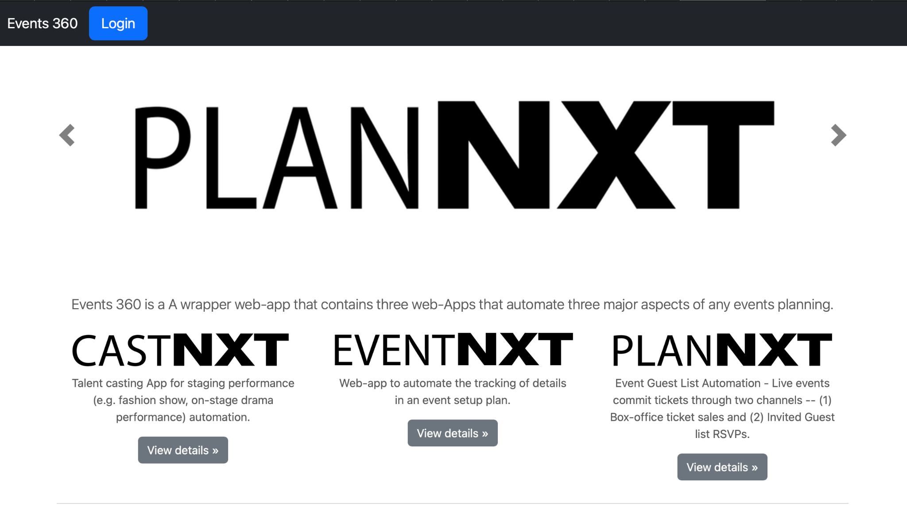
Events 360 Homepage

Slide 6
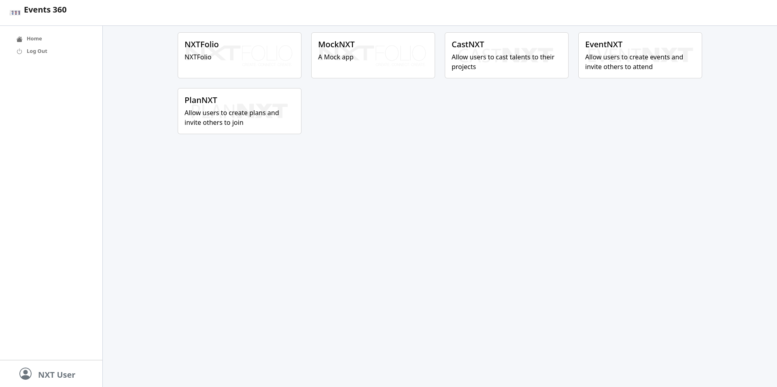
Unified User Dashboard

Slide 7
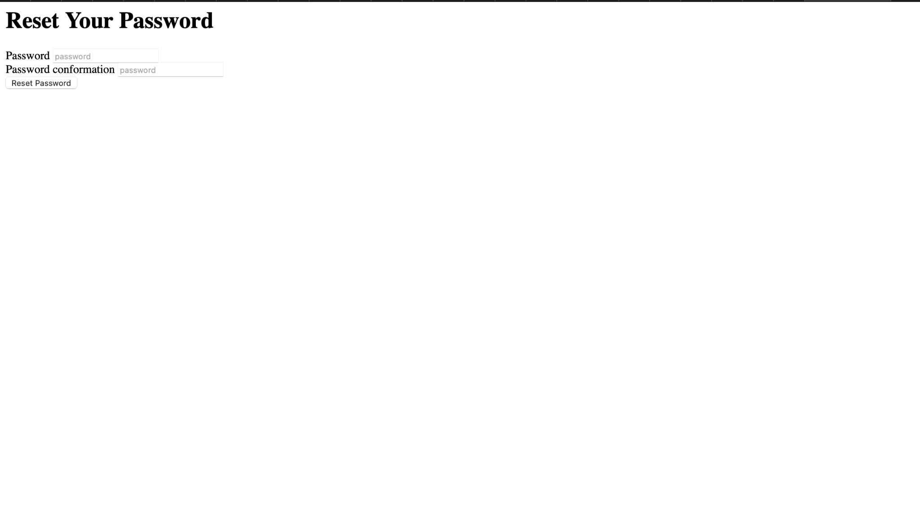
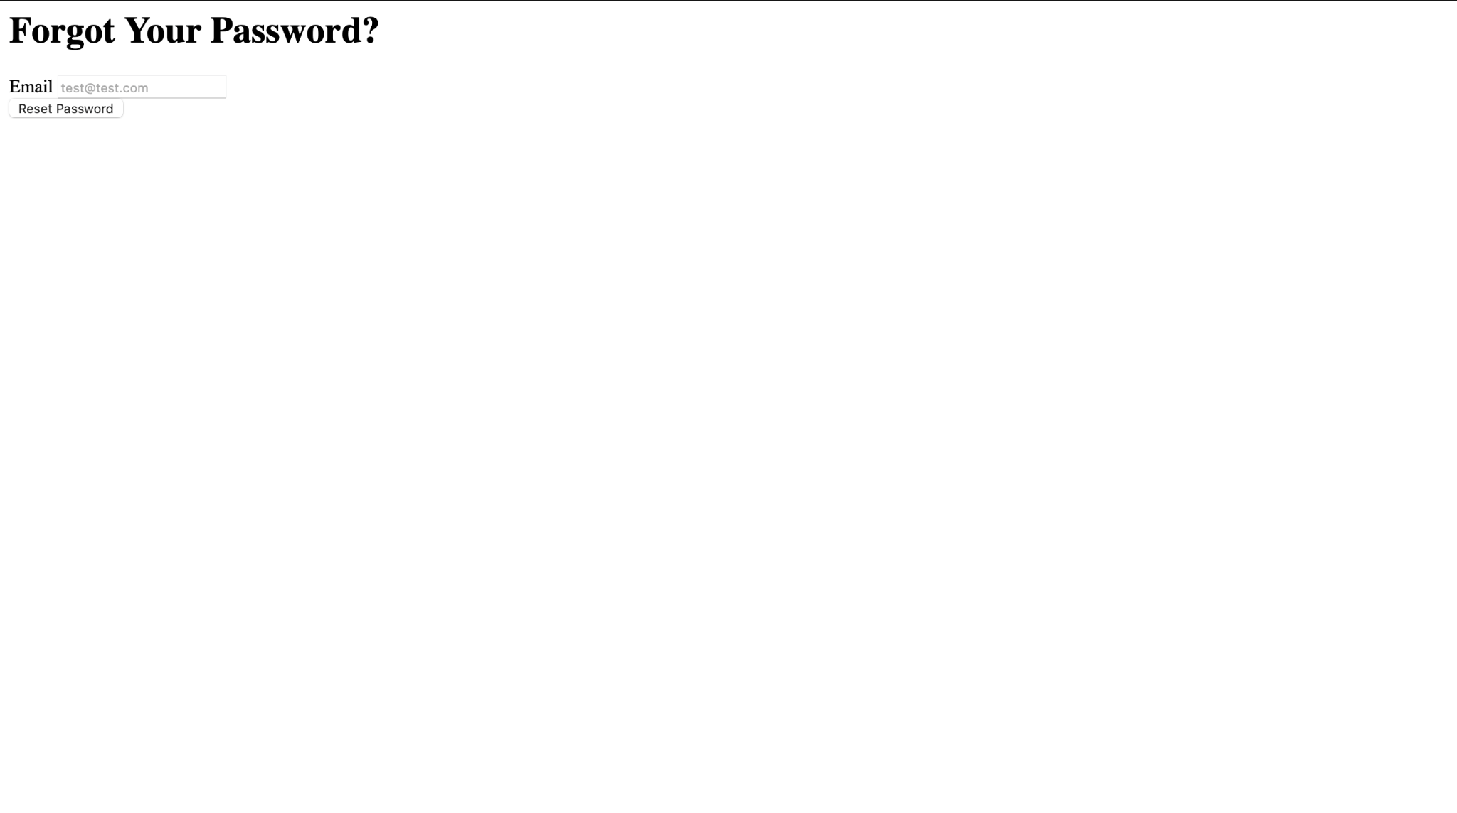
Forgot Password page

Slide 8
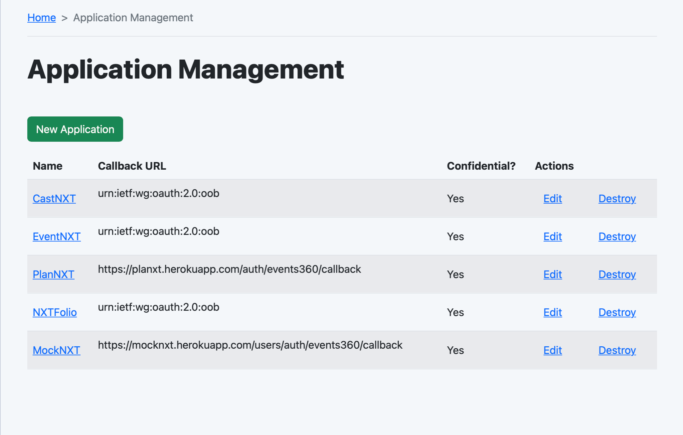
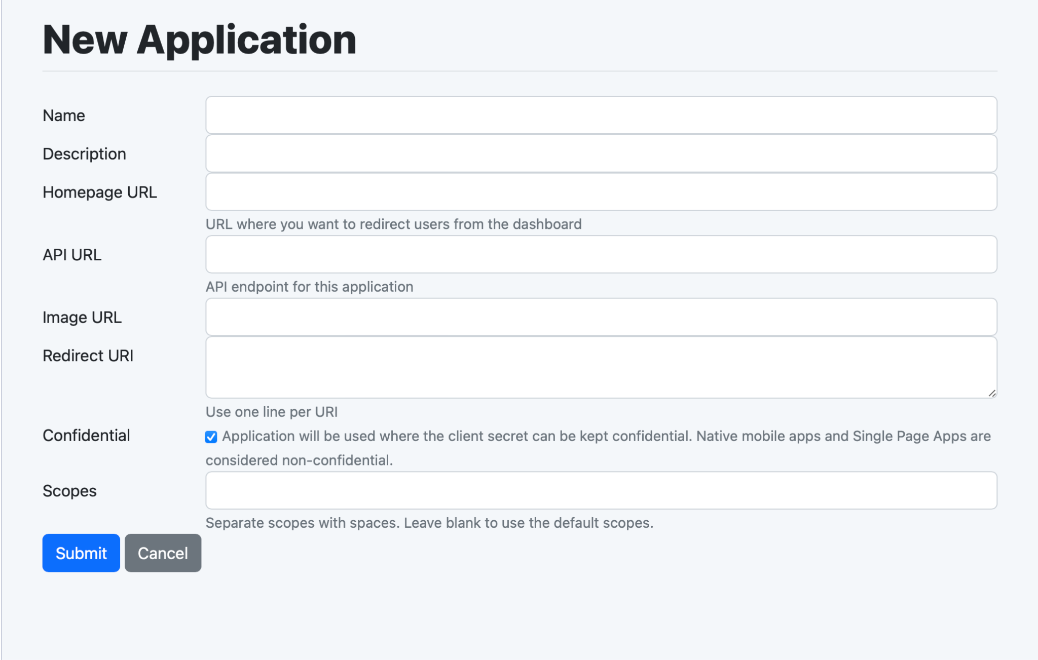
Add Application

Slide 9
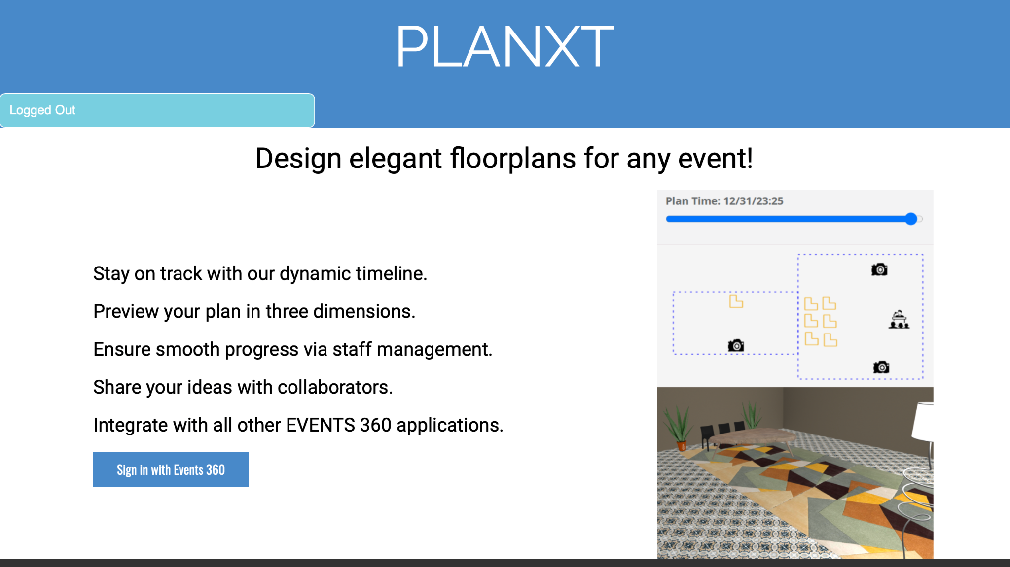
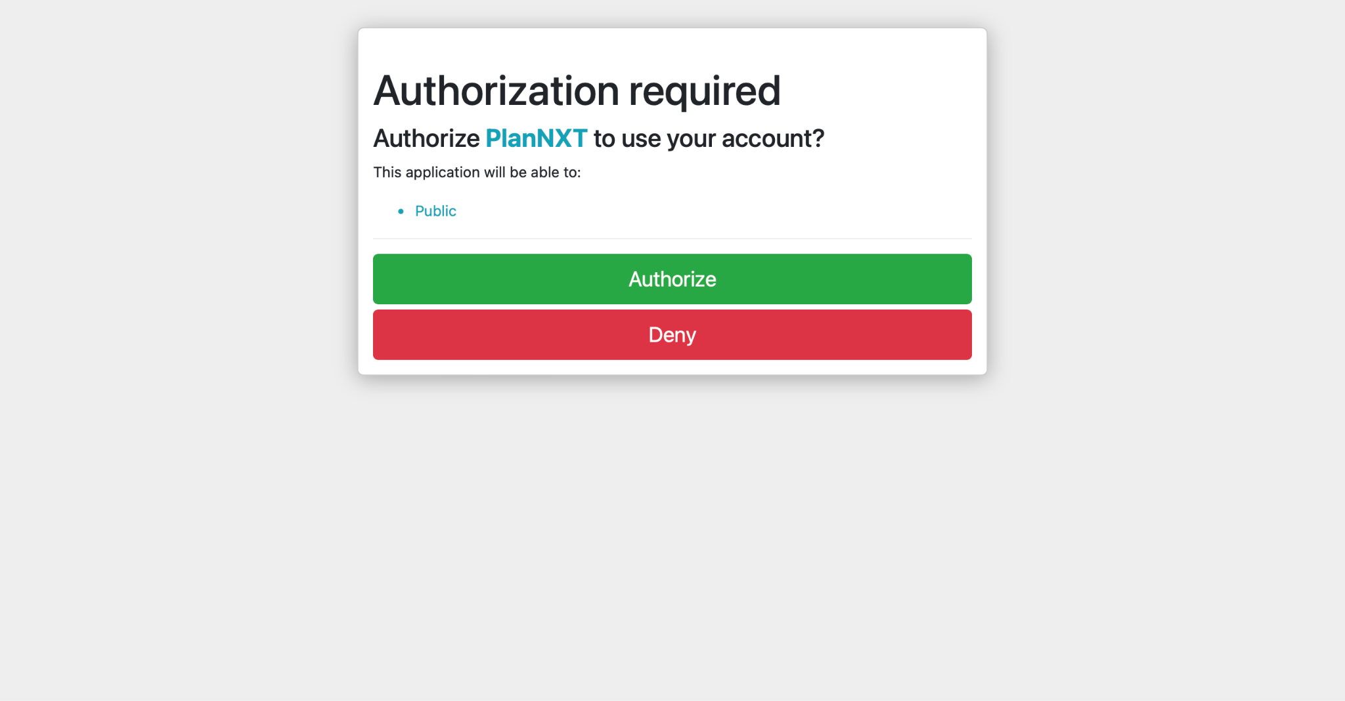
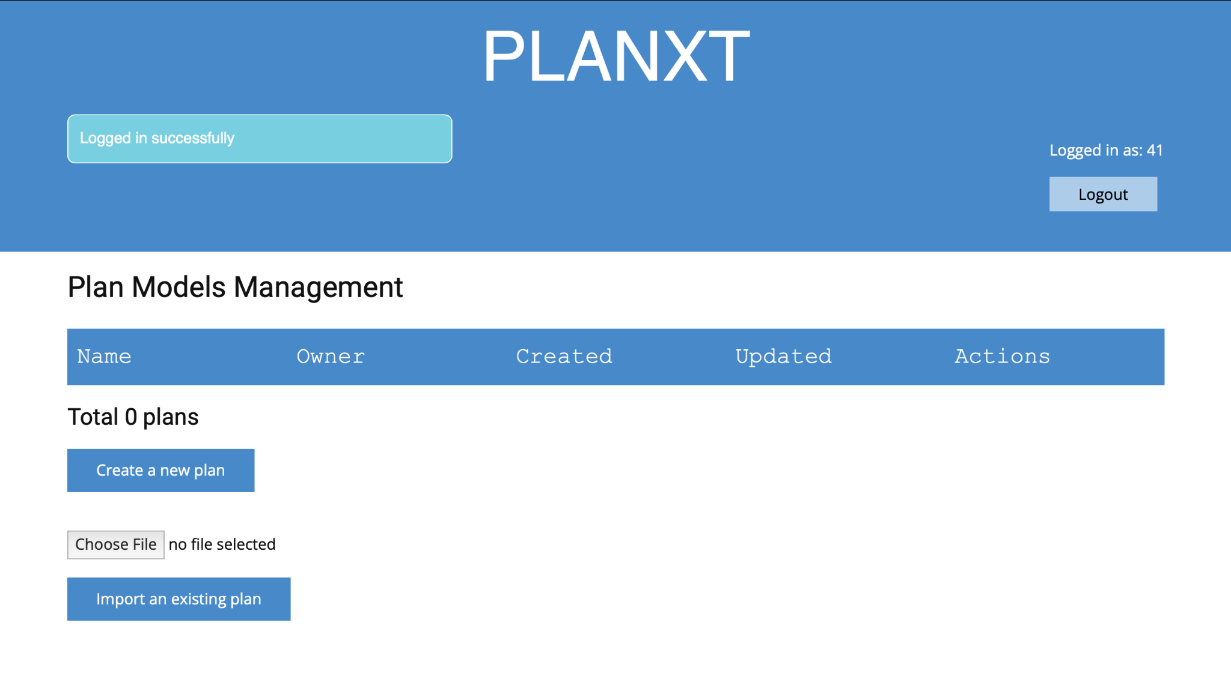
OAuth

Slide 10
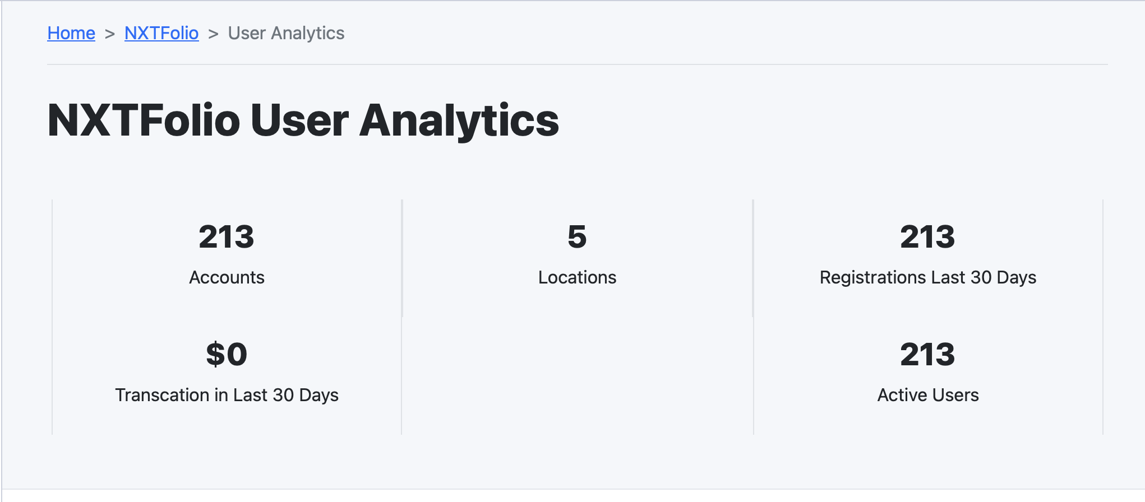
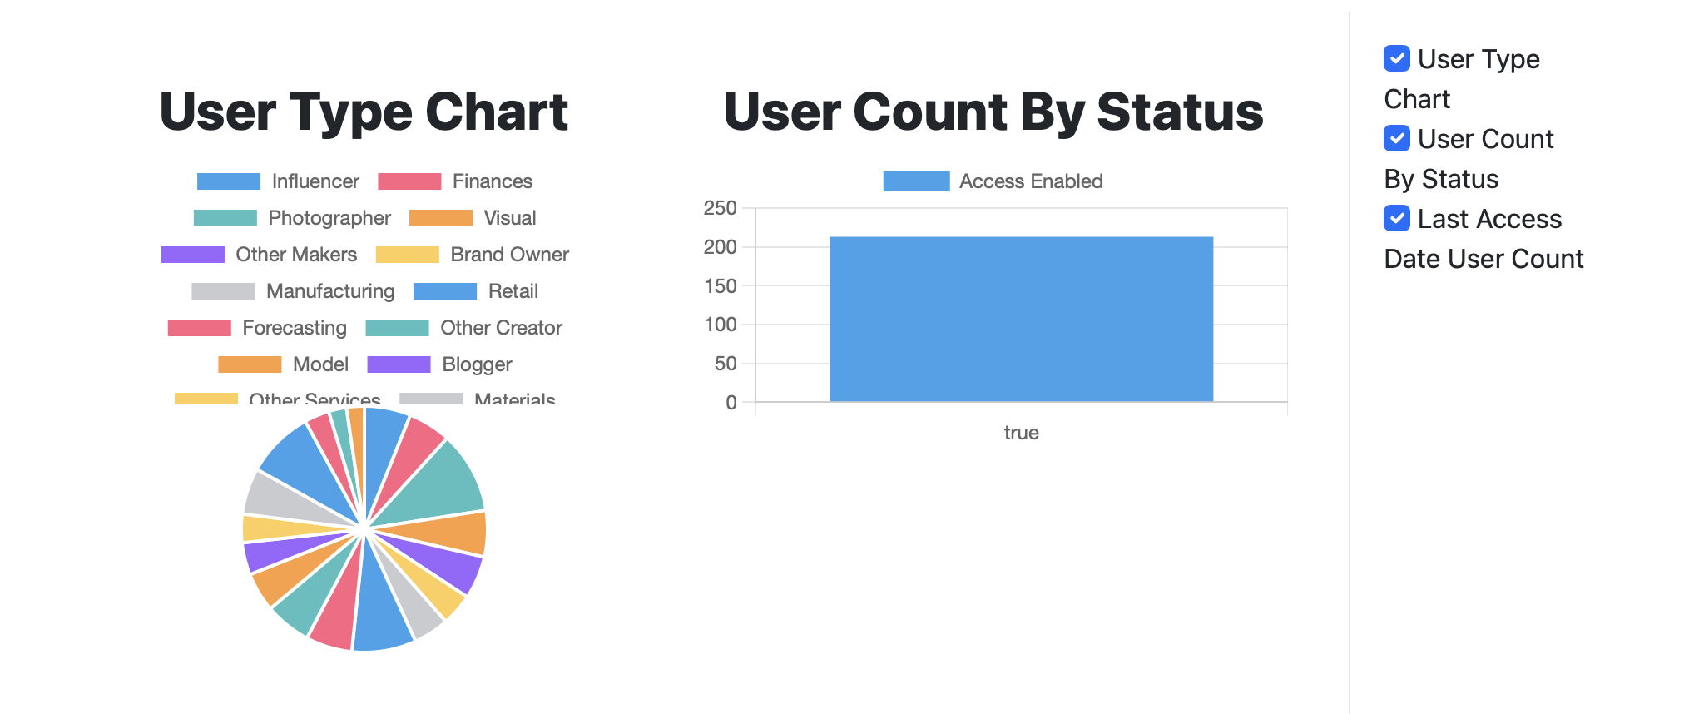
User Analytics

Slide 11
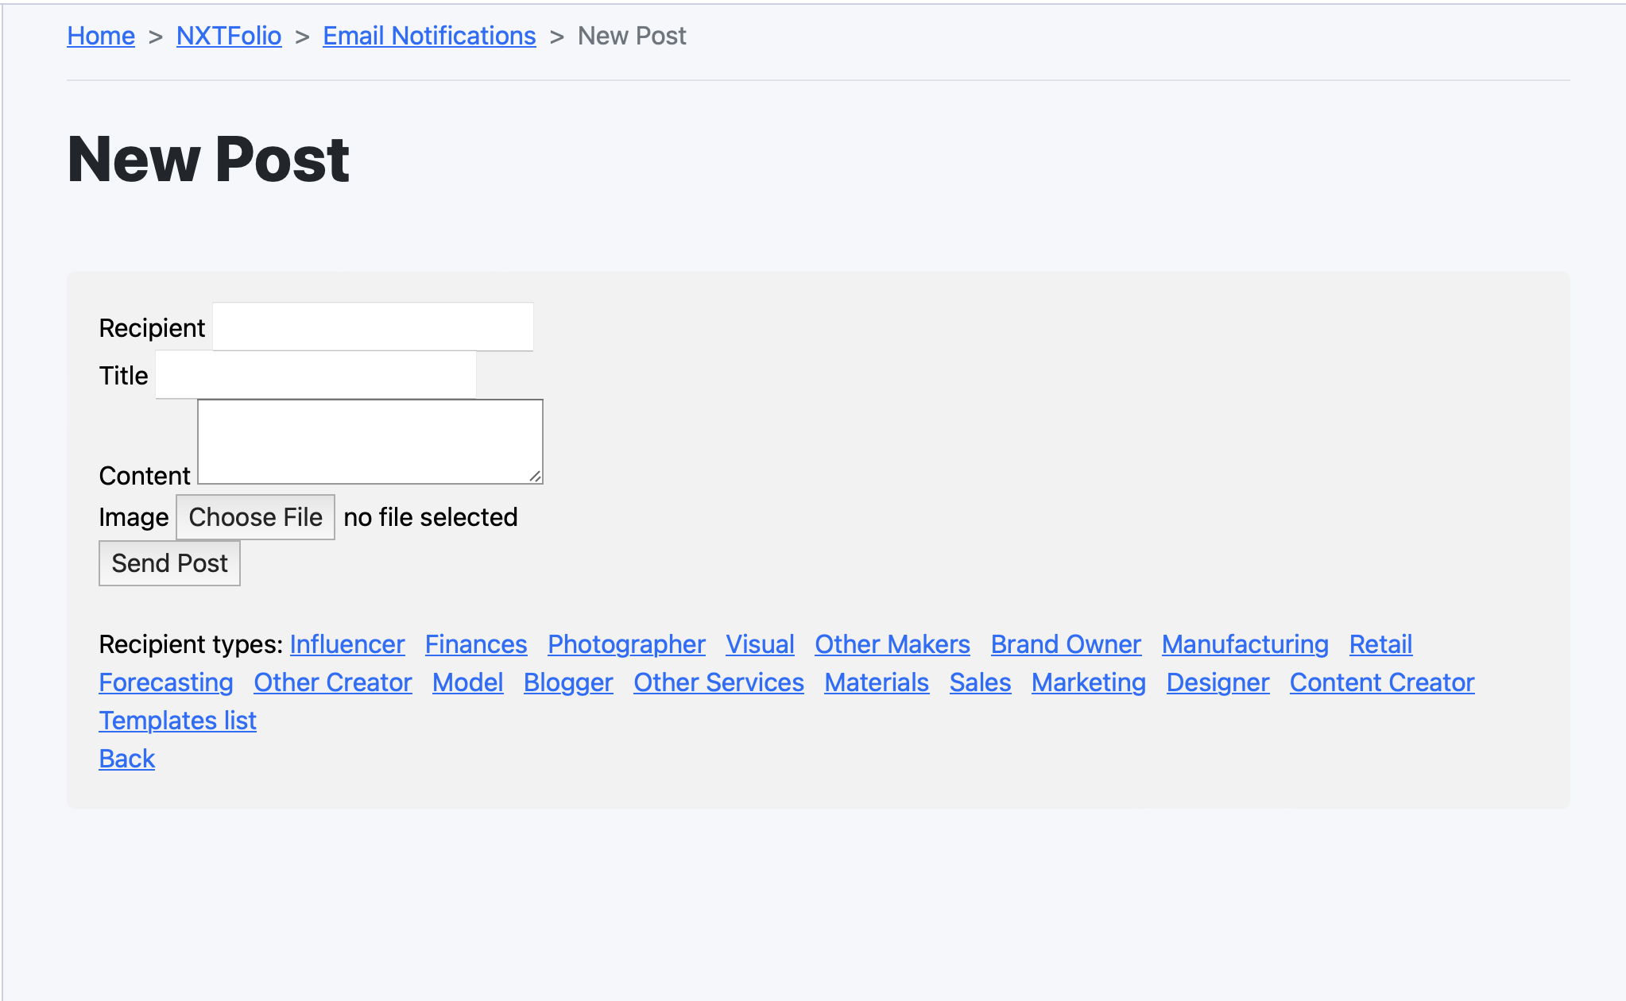
Email Templates

Slide 12
Lessons
Ruby On Rails
Learned about OAuth
What analytics are useful for a CRM
Efficient way to communicate between multiple teams
Version control system to collaborate on a Project
Software testing(TDD + BDD) and Github CI

Slide 13
Challenges
Communicating and coordinating with other teams specifically in relation to OAuth and Data Analytics
Client had vague requirements often changed requirements in the middle of an iteration.
Legacy code was malfunctioning and hard to read
Learning new technologies (Oauth, ChartJS, Bootstrap)

Slide 14
Thank You !!

